Slide 1
Number Guessing Game Using Python Tkinter Module

Slide 2
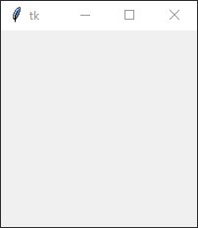
Tkinter Training by projects
# import necessary libraries
from tkinter import *
from PIL import ImageTk, Image
import random
import math
# create window
root = Tk()
# create loop so it will not close until user close it
root.mainloop()
Result

Slide 3
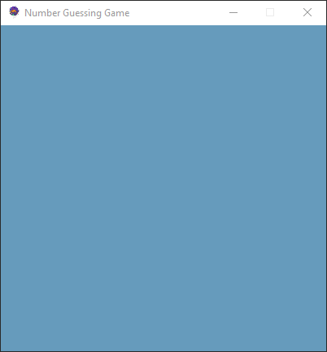
Let’s set Geometry and fixed size for window
# set Geometry Note that 400 (letter x as multiply ) 400
root.geometry("400x400")
# change logo
logo = PhotoImage(file="E:/mazenchannel/learn python with projects/0003-Number guessing game in python Tkinter/ico.png")
root.iconphoto(False, logo)
# change back ground color for window
root.config(bg="#669bbc")
# set window to fixed size
root.resizable(False, False)
# change window title
root.title("Number Guessing Game")
Result

Slide 4
Create variables we will use later
# create variables to we will use for our main app
# variable to count which click we in now
steps = 0
# variable count user played attempts
count = 0
# variable to ask user to input the upper range for game
upper_bound = 0
# variable to ask user to input the lower range for game
lower_bound = 0
# variable to program to generate random number
comp = 0
# variable to calculate available attempts to user based on calculation
attempts = 0
Result

Slide 5
Define Main function
# define main function called start to our app what it will do after player click button
def start():
# make variables global so we can update it out side the function
global steps
global count
global upper_bound
global lower_bound
global comp
global attempts
# check if this is first click on button
if steps == 0 :
# if yes first click edit button text to be Enter
b.config(text="Enter")
# and change color to be same as beginning
b.config(bg="#780000", fg="black")
# and change color to be same as beginning for info label
info.config(bg="#43aa8b", fg= "black")
# and change text for info label to ask user for upper range
info.config(text="Please enter upper bound")
# and add 1 to steps so the next click we will know it's second click
steps += 1
Result

Slide 6
Define Main function
# check if this is second click
elif steps == 1 :
# get inputs and assign it to variable upper bound to be the upper of range
upper_bound = e_txt.get()
# change text in info label to ask player for enter lower for range
info.config(text="Please enter lower bound")
# add 1 to steps so next click will be third
steps += 1
# check if this third click
Result

Slide 7
Define Main function
# check if this third click
elif steps == 2 :
# get inputs and assign it to variable lower bound to be the lower of range
lower_bound = e_txt.get()
# generate random number and assign it to our comp variable
comp = random.randint(lower_bound, upper_bound)
# calculate attempts and assign it to our attempts variable
attempts = round(math.log(upper_bound-lower_bound+1, 2)-2)
# change button text to be check
b.config(text="check")
# change info label text to ask user to guess number and show him how many guess he can play before lose
info.config(text=f"Try to guess the right number in {attempts} attempts")
# add 1 to steps so we know the next click will be fourth
steps += 1
Result

Slide 8
Define Main function
# check if we now in fourth click or more
elif steps >= 3:
# player played first hand so we add 1 to count
count += 1
# check if played hands less than available hands to play
if count < attempts:
# get user input and assign it to guess variable
guess = e_txt.get()
Result

Slide 9
Define Main function
# check winning condition if user guessed right number
if guess == comp:
# change info label text to congratulation you win and show number of hand played to win
info.config(text=f"Congratulations you did it in {count}")
# change info label back ground color and text color
info.config(bg="#c1121f", fg= "#fdf0d5")
# change button text to be restart
b.config(text="Restart")
# change button color
b.config(bg="#c1121f", fg="#fdf0d5", activebackground="#fdf0d5", activeforeground="#c1121f")
# rest steps to be 0 so if button clicked app will start function for the above code lines
steps = 0
# check if guessed number > generated number
elif guess > comp:
# change info label text to be too high
info.config(text=f"You guessed too high! used {count} from {attempts} attempts")
else: # check if guessed number < generated number
#change info label text to be too low
info.config(text=f"You Guessed too small! used {count} from {attempts} attempts")
Result

Slide 10
Define Main function
# check if this played hand is last available hand
elif count >= attempts:
# change info label text
info.config(text=f"The Number is {comp}")
# change color for info label
info.config(bg="#c1121f", fg= "#fdf0d5")
# change button text
b.config(text="Restart")
# change button color
b.config(bg="#003049", fg="#fdf0d5", activebackground="#fdf0d5", activeforeground="#003049")
# reset steps to start from beginning
steps = 0
# reset hand played
count = 0
Result

Slide 11
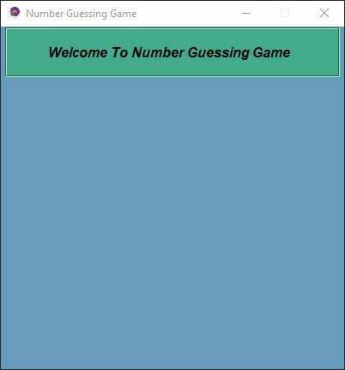
To create label
# create label to welcome player and update it to show info
info = Label(root,text="Welcome To Number Guessing Game ",# add text to our label
font=("Arial","12", "bold", "italic"),# change font name and size and properties
bg="#43aa8b",# to change label color
fg="black",# to change text color
width=40,
wraplength=360,
justify="left",
height=3,
padx=10,# label width from inside
pady=0,# label hight from inside
bd=2,# border size
relief=GROOVE# label style
)
# put label into screen
info.pack(padx=5, pady=1)
Result

Slide 12
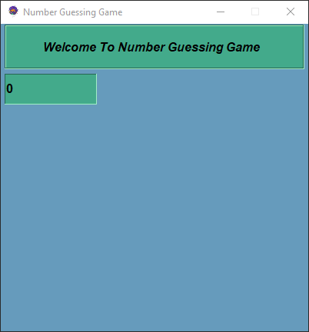
To create entry label
# create entry label to get entries fro user
e_txt = IntVar()
e = Entry(root,textvariable=e_txt,width=10,font="Arial 12 bold",border=1, bg="#43aa8b", fg="black", bd=1, relief=SUNKEN)
e.place(x=5, y=65, height=40, width= 120)
Result

Slide 13
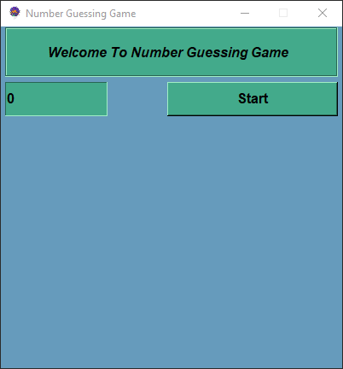
To create Button
# create enter button
b = Button(root, text="Start", command = start, padx=18,font="Arial 12 bold",bg="#43aa8b", fg="black",width=15,
activebackground="black",activeforeground="#43aa8b",relief=RAISED)
b.place(x=195, y=65, height=40, width=200)
Result

Slide 14
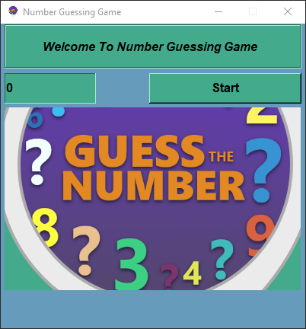
To create label with photo
# to add image need to create label
image_label = Label(root,image=logo,width=385, height=360,bg="#43aa8b",fg="black")
image_label.pack(padx=5, pady=50,)
Result

Slide 15
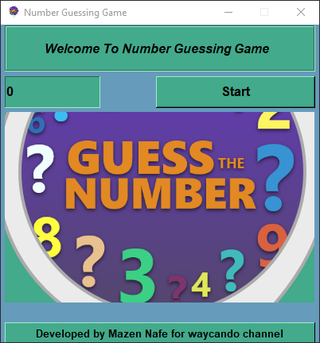
To create footer label
# add footer
license_label = Label(text="Developed by Mazen Nafe for waycando channel",width=36,
font="Arial 10 bold", bg="#43aa8b", fg="black", padx=50, pady=5, bd=1, relief=RAISED)
# add label to window
license_label.place(x=5, y=375)
Result

